Slide 1

Topic: “Transaction integrity challenges of Microservices in cloud and possible approaches”
By,
Arpitha Hegde

Slide 2
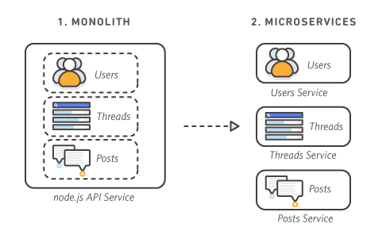
What are Microservices
Microservices are an architectural style to software development where an application is composed of small independent services.
Monolithic vs Microservices

Slide 3
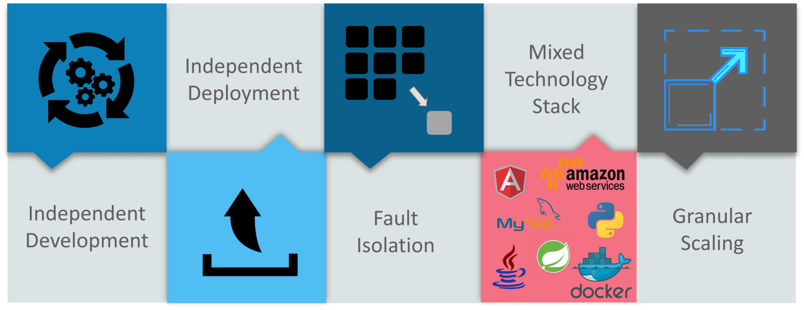
Benefits of Microservice

Slide 4
What are Transactions?
Transaction is a unit of work that must either happen in full or not at all.
Transaction adheres to a principle called ACID
Atomicity, Consistency, Isolation and Durability.
There are 2 types of possible data sources where transactions can occur.
Local : Operations executes in the same resource.
Distributed : Operations are spread across multiple resources. Microservice architecture is a distributed systems in nature.

Slide 5
Transaction Handling in Microservices
There are approaches existing in the market for managing distributed transactions.
Two-Phase Commit protocol (2PC)
Prepare Phase : All participants of the transaction prepare for commit and notify the coordinator that they are ready to complete the transaction
Commit or rollback phase : Either a commit or a rollback command is issued by the transaction coordinator to all participants
Eventual Consistency and Compensation / SAGA
It ensures that the system would be eventually consistent at some point in the future.
This model does not enforce distributed ACID transactions across microservices.
Eventually consistent services provide BASE (Basically Available, Soft state, Eventual consistency) semantics.
SAGA is an architecture by which we can implement a transaction that is spanning between multiple services.

Slide 6
Why Transaction Handling is Important
Transaction management is one of the most significant part of any application for data consistency and integrity.
When application uses multiple services from different sources, we can never be sure of data consistency in an easy manner, especially microservices. This is so, as there is no direct and simple way of maintaining ACID principles across multiple databases. This is where the real challenge lies for transaction management in Microservices.
In a normal environment the database is capable of handling transactions and data is available under same server, the server manager assumes this responsibility.
Whereas in distributed transaction environment, the API manager becomes responsible for handling transactions and data aggregation.
Hence, maintaining integrity and consistency across all application data becomes the job of an external entity and most of the times the API manager.

Slide 7
Implemented Approach
Driving transactions through a framework, that are externally managed and loosely coupled.
The responsibilities include,
Binding all services together.
Keep track of transactions.
Provide interfaces for APIs to handle rollbacks.
Provide mechanism to decide between sync and async.
Provide interfaces for logging and other diagnostic mechanisms.
Consider latency, waiting and re-tries.

Slide 8
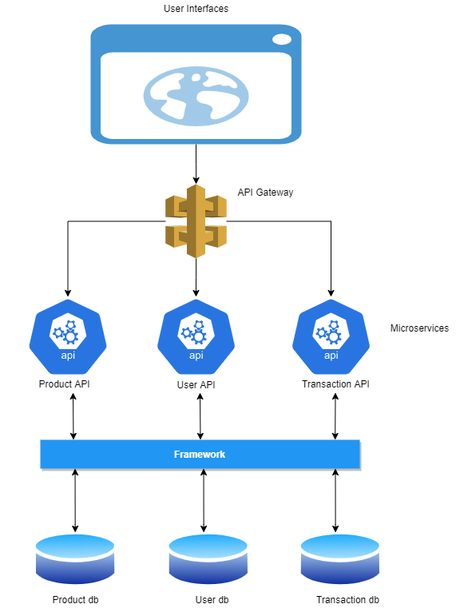

Slide 9
Implementation Outline
Created a project with three micro services.
Created an implementation for a framework.
These services are .Net Core Restful API’s.
The services are:
Product API
User API
Transaction API
These services subscribe to an external framework.
The framework will take over the responsibilities of managing transactions and notifications.

Slide 10
Comparing with existing approaches
Most of the existing methods are solving a problem with an approach. This always comes with a pros and cons.
But a clean framework can help to integrate different solutions of transaction needs.

Slide 11
Challenges
There are too many data storage technologies and it would require a deep study to stabilize the approach.
Technically microservices can live in various geographic locations and such services turn out to be a complex implementation
Additional framework will not account, service performance or any other indirect effects.

Slide 12
References
https://ieeexplore-ieee-org.huaryu.kl.oakland.edu/document/7742259
https://ieeexplore-ieee-org.huaryu.kl.oakland.edu/document/08645853
https://www.baeldung.com/transactions-across-microservices
https://aspiresoftware.in/blog/transaction-management-between-microservices/

Slide 13
Thank you!

